Slide 1
CSF211 Data Structures & Algorithms
Topics: Stacks & Queues
Dr. J. Angel Arul Jothi
Department of Computer Science

Slide 2
Text book Chapter 2
Sections 2.1.1 and 2.1.2

Slide 3
Linear data structures
Data is organized in a linear fashion
Examples
  Stacks
  Queues
  Lists
CS F211 DATA STRUCTURES & ALGORITHMS

Slide 4
Non-linear data structures
Data is not organized in linear fashion
Relationships exist among data
Examples
  Trees
  Graphs
CS F211 DATA STRUCTURES & ALGORITHMS

Slide 5
Abstract data type (ADT)
It is a data type defined by
  Set of values
  Set of operations
The ADT only mentions what operations are to be performed but does not specify how these operations will be implemented
CS F211 DATA STRUCTURES & ALGORITHMS

Slide 6
Operations on Data structures
Add data (insert)
Delete data (remove)
Search data (search)
CS F211 DATA STRUCTURES & ALGORITHMS

Slide 7
Stacks
The Stack data structure stores data objects in last-in first-out (LIFO) manner
Insertions and deletions are done at one end - top
Stack operations:
  push: inserts an element
  pop: removes and returns the last inserted element
  top: returns the last inserted element without removing it
  size: returns the number of elements stored
  isEmpty: indicates whether elements are stored or not. Returns true if there are no elements otherwise it returns false
CS F211 DATA STRUCTURES & ALGORITHMS

Slide 8
Array implementation of Stack
Let array S be a stack with N as maximum size
Top of the stack (TOS)
  Integer variable t denote the TOS
  Initialize t as -1
  Points to the index of the top element in the stack
…
S
0
1
2
top
N-1
CS F211 DATA STRUCTURES & ALGORITHMS

Slide 9
Array implementation of Stack - Pseudocode
Algorithm size()
return t+1
Algorithm isEmpty()
if t = -1
    return true
    return false
Algorithm top()
if isEmpty() then
return Error
return S[t]
Algorithm push(o)
if size()=N then
return Error
t ← t+1
S[t]← o
Algorithm pop()
if isEmpty() then
return Error
e ← S[t]
t ← t-1
return e
CS F211 DATA STRUCTURES & ALGORITHMS

Slide 10
Array implementation of Stack
Exceptions/Errors
  Attempting pop or top on an empty stack
  Attempting to push into a full stack
  Stack full is overflow error
  Stack empty is underflow error
CS F211 DATA STRUCTURES & ALGORITHMS

Slide 11
Example
Consider array based implementation of stack S. Assume that the maximum size of the stack is 3 elements. Show the contents of the STACK (trace through) at each step, for the following sequence of operations. Mention exceptions like empty/full if any.
Operations: PUSH (1), POP, PUSH (2), PUSH (3), PUSH (4), PUSH (5), POP, POP, POP, POP
CS F211 DATA STRUCTURES & ALGORITHMS

Slide 12
Applications of Stack
  “Back” button functionality in a Web browser
  Undo operation in a text editor
  Conversion of infix to postfix expression
Evaluation of postfix expression
Matching symbols (, {
Recursion and function calls
CS F211 DATA STRUCTURES & ALGORITHMS

Slide 13
Evaluating a postfix expression
Start with an empty stack and postfix expression P
Scan P from left to right examining one element at a time
while not reached the end of P do
if an operand is found then
Push it onto the stack
if an operator(op)is found then
Pop the stack and call the value A
Pop the stack and call the value B
Evaluate B op A
Push the resulting value onto the stack
Pop the stack (this is the final value)
CS F211 DATA STRUCTURES & ALGORITHMS

Slide 14
Evaluating a postfix expression
Evaluate the postfix expression 2 3 1 * + 9 –
  Assume we have binary operators and all operands are single digit numbers
CS F211 DATA STRUCTURES & ALGORITHMS

Slide 15
  Conversion of infix to postfix expression
Infix expression
  standard form
  Assume that we have only the operators +, *, -, /, ^ and (,), and follow on the usual precedence rules
Start with an initially empty stack. Assume we also have an output. Read the input expression one element at a time from left to right
Operator | Precedence | Associativity
() | highest
^ |  | right
/, * |  | left
+, - | lowest
CS F211 DATA STRUCTURES & ALGORITHMS

Slide 16
  Conversion of infix to postfix expression
Print operands to the output as they arrive
If the incoming symbol is a left parenthesis, push it on the stack
If the incoming symbol is a right parenthesis, pop the stack and print the operators until you see a left parenthesis. Discard the pair of parentheses
If the stack is empty or contains a left parenthesis on top, push the incoming operator onto the stack
If the incoming symbol has higher precedence than the top of the stack, push it on the stack
If the incoming symbol has equal precedence with the symbol on the top of the stack, use associativity rules. If the incoming operator is left associative, pop and print the top of the stack and then push the incoming operator. If the incoming operator is right associative, push the incoming operator to the stack.
CS F211 DATA STRUCTURES & ALGORITHMS

Slide 17
  Conversion of infix to postfix expression
If the incoming symbol has lower precedence than the symbol on the top of the stack, pop the stack and print the top operator. Then test the incoming operator against the new top of stack.
At the end of the expression, pop and print all operators on the stack
CS F211 DATA STRUCTURES & ALGORITHMS

Slide 18
  Conversion of infix to postfix expression
Example
  Convert the following infix to postfix expression
  a + b *c + (d * e + f) * g
CS F211 DATA STRUCTURES & ALGORITHMS

Slide 19
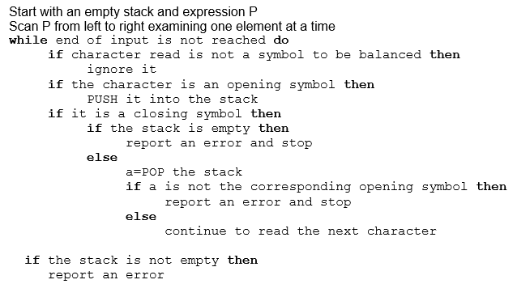
Balancing of symbols
CS F211 DATA STRUCTURES & ALGORITHMS

Slide 20
Balancing of symbols
Example
  Check if the symbols in the expression are balanced
  (A+B) + (C-D)
CS F211 DATA STRUCTURES & ALGORITHMS

Slide 21
Method calls
Stacks are an important application of modern procedural languages, such as C, C++, and Java
During the execution of a program the runtime environment maintains a (method) stack
The elements of the method stack are frames
Each frame corresponds to a method that has not terminated
The topmost frame corresponds to currently active method
Frames hold details like
  register values
  the return address
CS F211 DATA STRUCTURES & ALGORITHMS

Slide 22
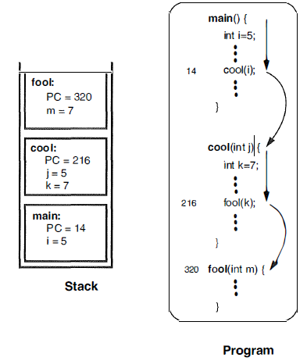
Function/Method stack
CS F211 DATA STRUCTURES & ALGORITHMS

Slide 23
Queues
The Queue data structure stores data objects in first-in first-out (FIFO) manner
Insertion – Enqueue – Rear end
Deletion – Dequeue – Front end
Error conditions
  Deleting an element from an empty queue
  Inserting an element into a already full queue
CS F211 DATA STRUCTURES & ALGORITHMS

Slide 24
Queues
Operations
  enqueue: inserts an element at the rear end of the queue
  dequeue: removes and returns the element at the front of the queue
  size: returns the number of elements
  isEmpty: indicates whether the queue is empty
  front: returns the element at the front without removing it
CS F211 DATA STRUCTURES & ALGORITHMS

Slide 25
Array implementation of Queue– Normal configuration
Normal configuration (Linear Queue)
  Let Q be an array representing a Queue
  N be the maximum size
  Two variables keep track of the front and rear
    f index of the front element
    r index immediately past the rear element
    Initially, f=r=0. The queue is empty if f==r. The queue is full if r == N
Q
0
1
2
f
r
N-1
CS F211 DATA STRUCTURES & ALGORITHMS

Slide 26
Array implementation of Queue – Normal configuration
Algorithm enqueue(o)
if r=N then
return Error
Q[r]← o
r ← r+1
Algorithm dequeue()
if f=r then
return Error
e ← Q[f]
f ← f+1
return e
CS F211 DATA STRUCTURES & ALGORITHMS

Slide 27
Array implementation of Circular Queue
Wraparound configuration (Circular Queue)
  Queue is a circular array
    Indices 0, 1, 2, …, N-1, 0, 1, …
  Enables to use the entire queue in a circular fashion
  Can store maximum of N-1 elements
normal configuration
Q
0
1
2
f
r
N-1
wrapped-around configuration
Q
0
1
2
r
f
N-1
CS F211 DATA STRUCTURES & ALGORITHMS

Slide 28
Array implementation of Circular Queue - Pseudocode
Algorithm size()
return (N-f+r) mod N
Algorithm isEmpty()
if f = r
    return true
    return false
Algorithm front()
if isEmpty() then
return Error
return Q[f]
Algorithm dequeue()
if isEmpty() then
return Error
o ← Q[f]
f ←(f+1)mod N
return o
Algorithm enqueue(o)
if size()= N-1 then
return Error
Q[r]←o
r ←(r +1)mod N
CS F211 DATA STRUCTURES & ALGORITHMS

Slide 29
Example
Consider a circular queue Q in wrapped around configuration. Assume that the maximum size of the queue is 4. Show the contents of the queue (trace through) at each step, for the following sequence of operations. Mention exceptions like empty/full if any.
Operations: ENQUEUE (Z), DEQUEUE, DEQUEUE, ENQUEUE (X), ENQUEUE (F), ENQUEUE (D), ENQUEUE (B)
CS F211 DATA STRUCTURES & ALGORITHMS

Slide 30
Applications of Queue
Multi programming Operating systems
  FIFO CPU scheduling
Printer jobs
CS F211 DATA STRUCTURES & ALGORITHMS

Slide 31
Thank you
CS F211 DATA STRUCTURES & ALGORITHMS

